Slide 1

Progress Report Virginia Tech Roller Rig testing facility for wheel-rail contact simulation
Mehdi Ahmadian, Dan Pletta Professor and Director
Jay Dixit, Graduate Research Assistant
Karan Kothari, Graduate Research Assistant
Railway Technologies Laboratory
Virginia Tech

Slide 2
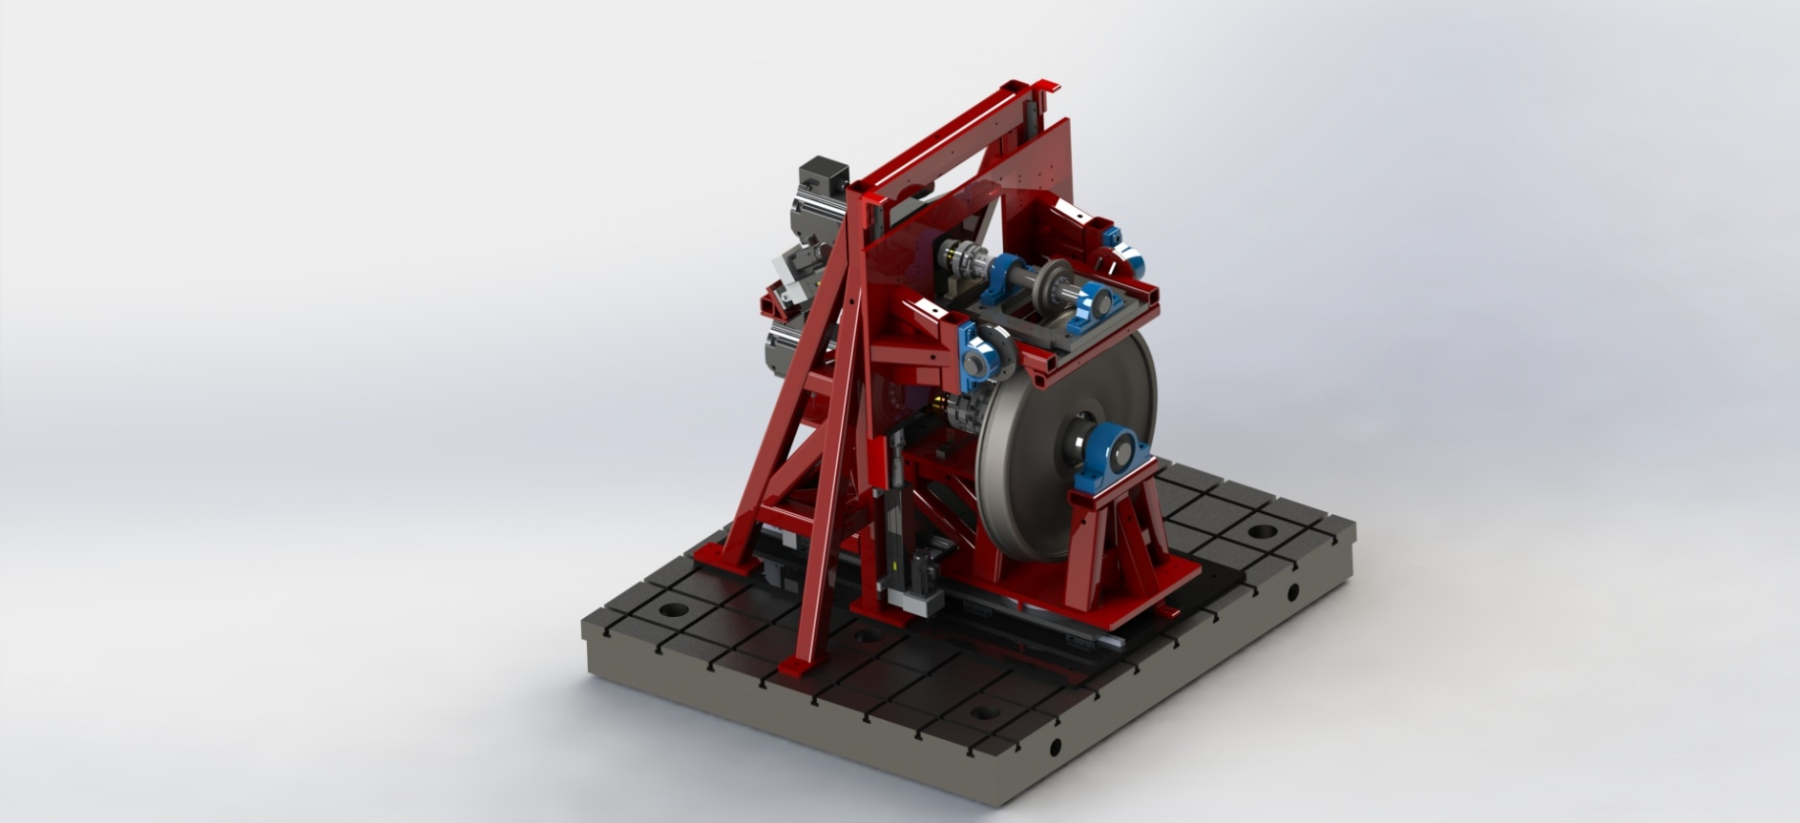
Overview
Overview of the Rig
1/4th scale vertical wheel-roller rig
Six independent DoF
5:1 roller to wheel ratio
Wheel: AAR-1B profile, 8” diameter
Roller(rail): US136, 40’’diameter
Envelope of movement:
Angle of attack: ±10 degree
Cant angle: ±10 degree
Lateral displacement: ±25.4 mm
2 independent drivelines for precise creepage control
Max. Simulated Velocity: 40 mph
Max. Simulated Load: 128 kN
Max. DAQ bandwidth: 48 kHz
Notes:
Overall dimensions: 80 * 80 * 75 in
Maximum simulated speed: 10 mph
Each Motors’ required power: 25 hp
Load frame of the Rig is made of 4×4×3/8” low-carbon steel tubing in a triangular form
Two shafts made of 1045 carbon steel connect the torque sensor couplings to the rotating bodies, through spherical bearings. Two spherical roller bearings hold the rotating shaft in each driveline ($4$-inch roller shaft and $3$-inch wheel shaft). Two heavy-duty keyless bushings are used to secure the wheels on the shafts.
A cast-iron T-slotted base plate, filled with non-shrinking grout, provides a rigid flat basement for the frame and the lateral linear guides underneath the roller structure with a top surface flatness accuracy of ±0.03mm. The base plate is anchored to the 6-inch floor of the CVeSS facility via ten 1.5-inch anchors

Slide 3
Description of Key Parts of the Roller Rig
Wheel and Roller Drivelines
Positioning Systems
Force Measuring System

Slide 4
Wheel and Roller Drivelines
Drivelines
High precision 20-bit encoder feedback
Independent position, velocity, acceleration and jerk control
Capable of simulating braking and traction creepage
Roller Gear Ratio: 25:1 Wheel Gear Ratio: 5:1
Notes:
Driveline components: 30 hp servomotor, low backlash heavy duty gearhead, torque-sensor, bearing, coupling, shaft, wheel/roller

Slide 5
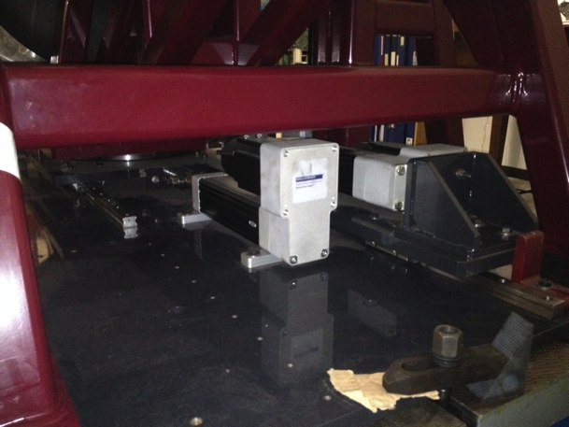
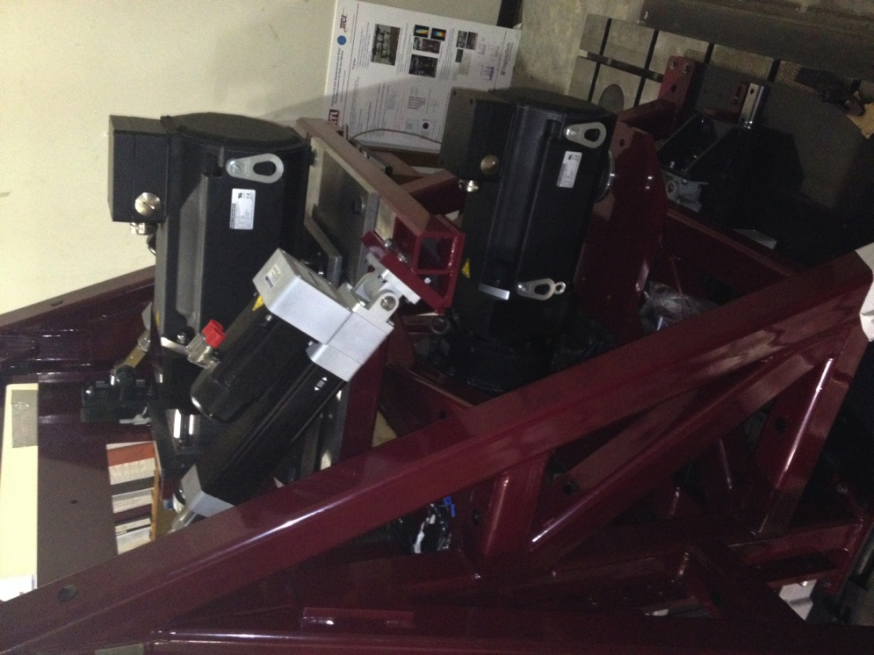
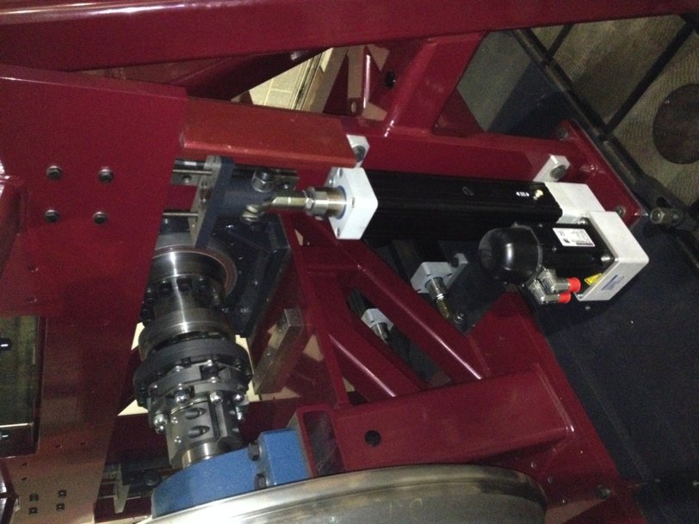
Positioning Systems
Positioning Systems
Six Linear actuators control four boundary conditions
Normal loading (contact pressure)
Angle of attack (AoA)
Lateral displacement
Cant angle
Precise positioning with 32-bit encoder feedback

Slide 6
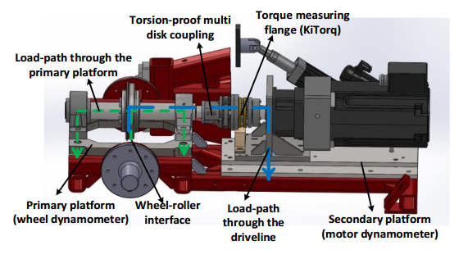
Force Measuring System
Force Measuring Platforms
Custom made dynamometers for acquiring contact forces and moments
Four tri-axial piezoelectric load cells per dynamometer
Piezoelectric load cells have a fast response to changing loads
Force-Moment obtained by coordinate transformations.
Load Paths as shown:

Slide 7
Measurement Capabilities
Measurements
Max. slip: 15%
Wheel velocity: 400 RPM
Roller velocity: 70 RPM
Max. contact forces
Normal load (Z): 32 kN
Max. longitudinal (X): 16 kN
Max. lateral (Y): 16 kN
Driveline torques
Instantaneous torque in driveline measured with less than 6.1Nm resolution
Kistler torque couplings and acquisition units measure driveline torque

Slide 8
Motion Controller and Data Acquisition
Motion Control and Data Acquisition
Easy, Fast and low-noise communication
Unified communication protocol provides an unprecedented servo update rate (48kHz)
Robust, and Expandable
SynqNET protocol has self-diagnostic and Plug-n-Play capabilities.
Multi-domain, Easy to use controller
Seamlessly embeds SynqNet, MATLAB, C, and XML programming environments with a user friendly GUI

Slide 9
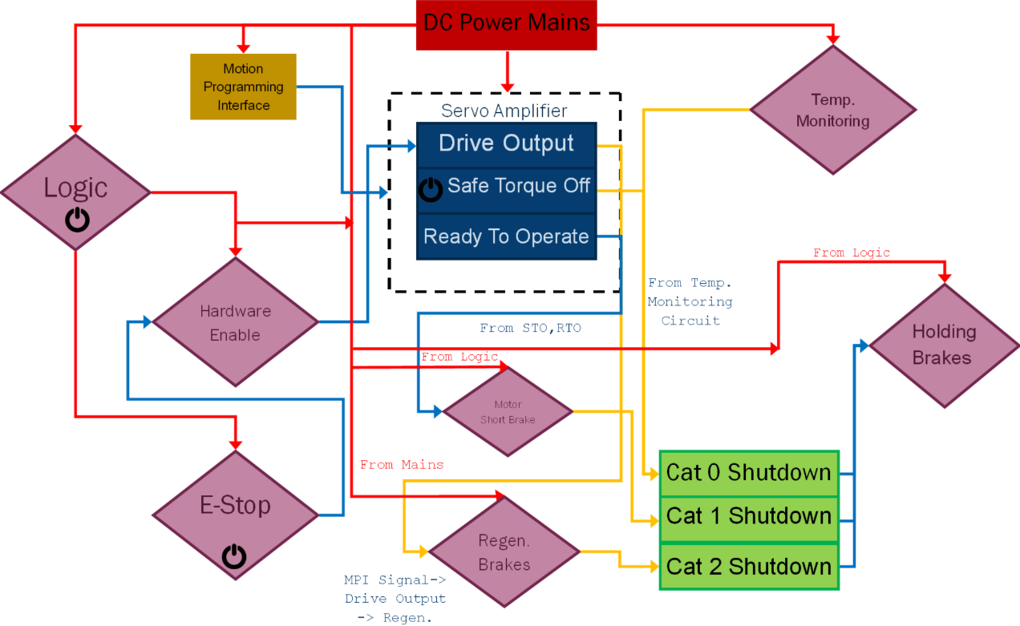
Safety Systems & Control Architecture
Safety Systems:
Layers
Notes:
Power, safety, and EMC systems satisfy ISO and IEC standards. They allow for performing all stop categories using the same hardware setup
Designs passed various reviews by motor manufacturer and system engineering consultants

Slide 10
Safety Systems & Control Architecture
Safety Systems:
Layers
Logic ON-OFF isolates the power circuits from motion control
Emergency stop circuit with smooth high-voltage cut-off
Ready-to-Operate (RTO) monitors internal faults such as motor over-temperature, under-voltage, over-speed, etc.
Safe-Torque-Off (STO) system monitors the safety gate
Hardware Enable controls the output stage of servo-amplifiers
Holding Brake for holding loads in stalled position
Regenerative Dynamic Braking: Braking achieved by dissipating the external regenerative voltage as heat
Motor Short Dynamic Braking to stop the motors in shortest time using motor internal electronics
Notes:
Power, safety, and EMC systems satisfy ISO and IEC standards. They allow for performing all stop categories using the same hardware setup
Designs passed various reviews by motor manufacturer and system engineering consultants

Slide 11
Measurement Accuracy

Slide 12
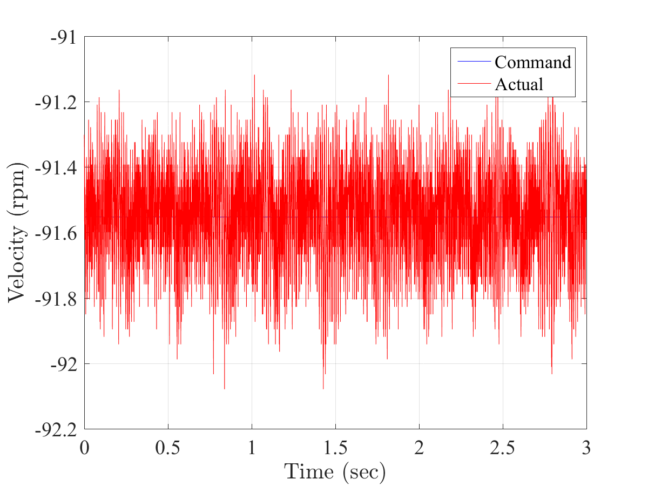
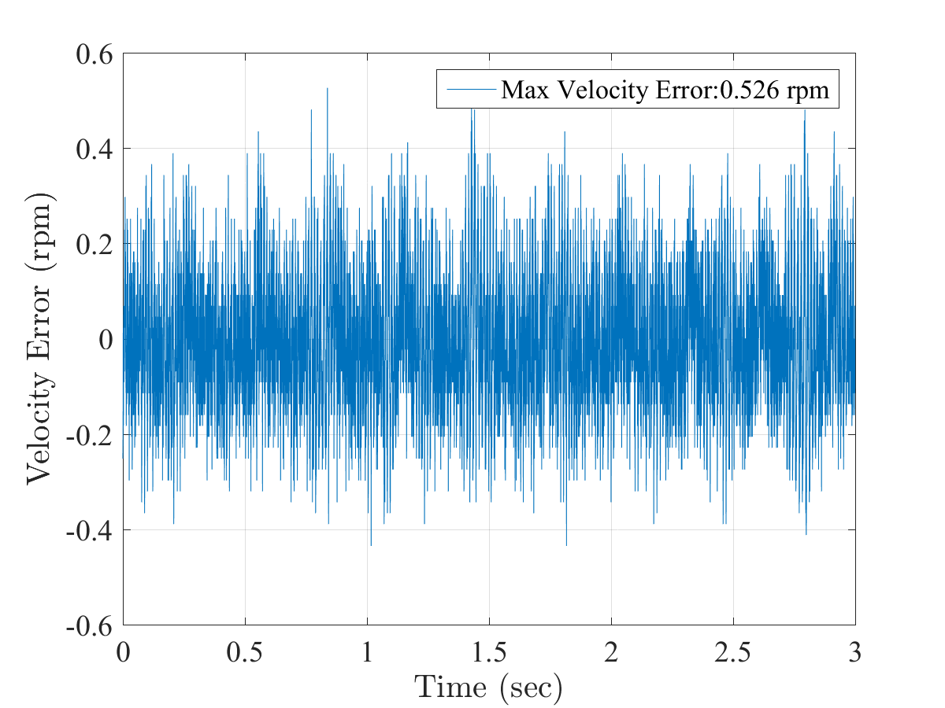
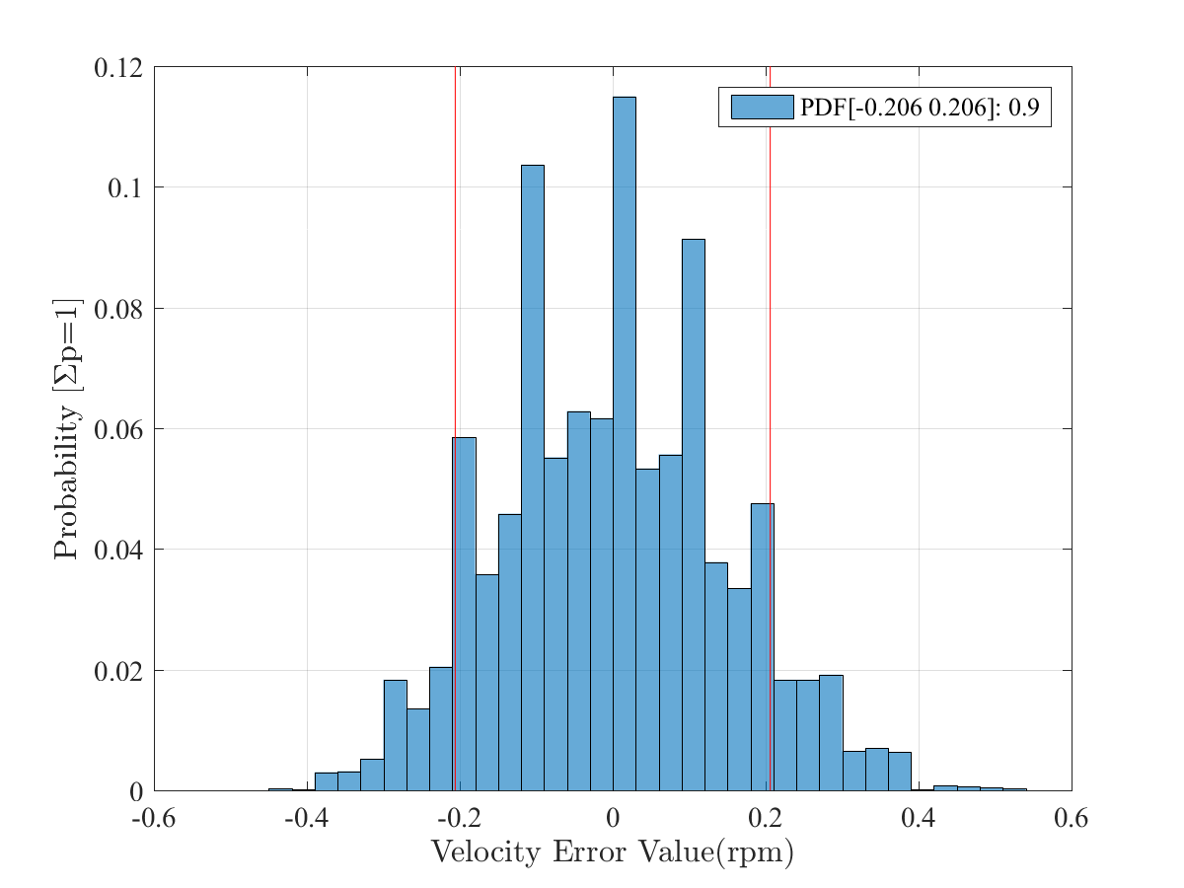
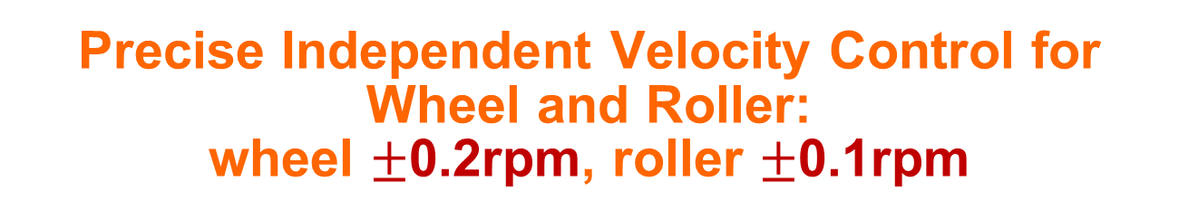
Precise Independent Velocity Control for Wheel and Roller: wheel $±$0.2rpm, roller $±$0.1rpm
Creepage Control
Wheel
Wheel
Wheel
Axis | Maximum error after frequency shaping | Maximum error after fine tuning (improvement) | 90th percentile error after fine tuning
Wheel | 1.516rpm | 0.526rpm (65.30%) | 0.206rpm
Roller | 1.282rpm | 0.221rpm (82.76%) | 0.104rpm

Slide 13
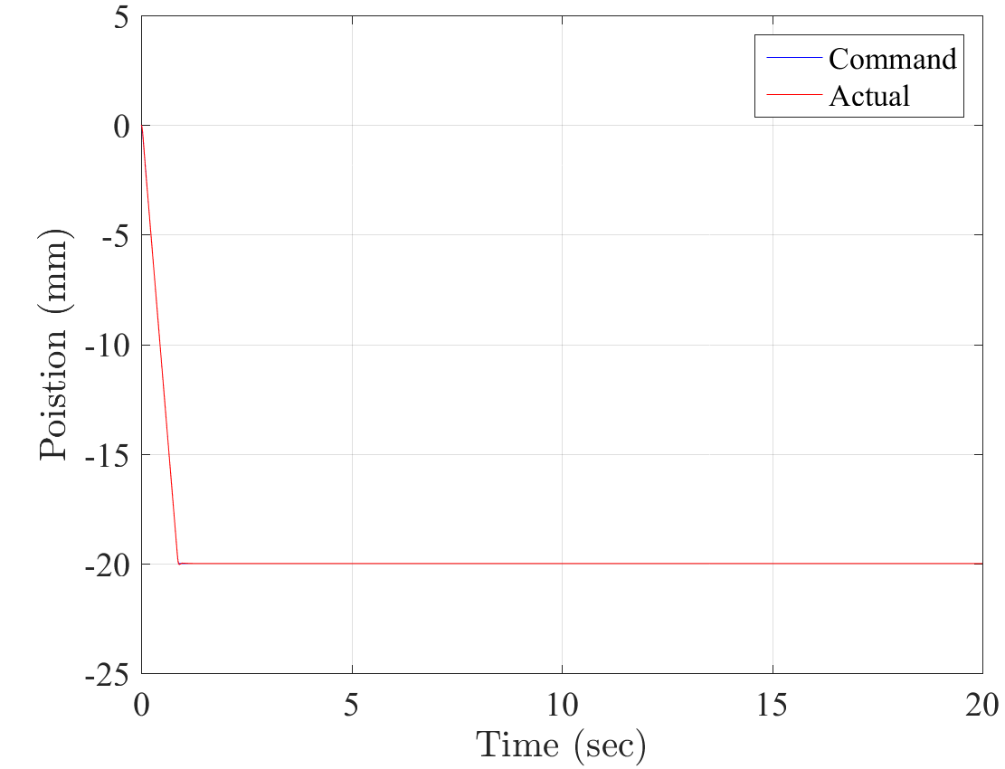
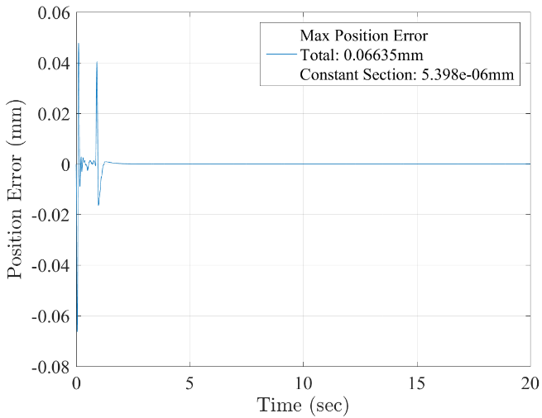
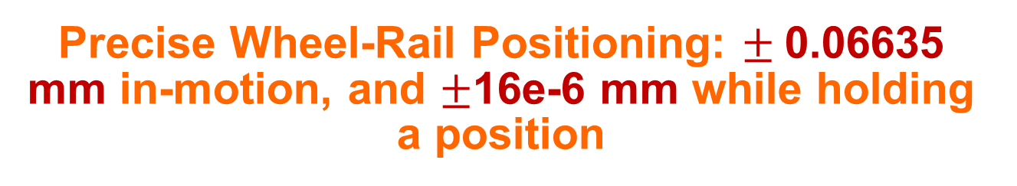
Precise Wheel-Rail Positioning: $±$0.06635 mm in-motion, and $±$16e-6 mm while holding a position
Wheel-Rail Positioning
Lateral
Lateral
Maximum position Error (mm)
Axis | In motion |  | Steady
 | after frequency shaping | after fine tuning (improvement) | after frequency shaping | after fine tuning (improvement)
Lateral (mm) | 0.1058 | 0.06635 (37.29%) | 8.516e-6 | 5.398e-6 (36.61%)
Vertical (mm) | 0.0515 | 0.00358 (93.05%) | 0.00323 | 8.567e-6 (99.74%)
Cant (mm) | 0.04832 | 0.01779 (63.18%) | 0.00668 | 1.607e-5 (99.76%)
AoA (mm) | 0.04304 | 0.02114 (50.88%) | 1.365e-5 | 1.017e-5 (25.50%)

Slide 14
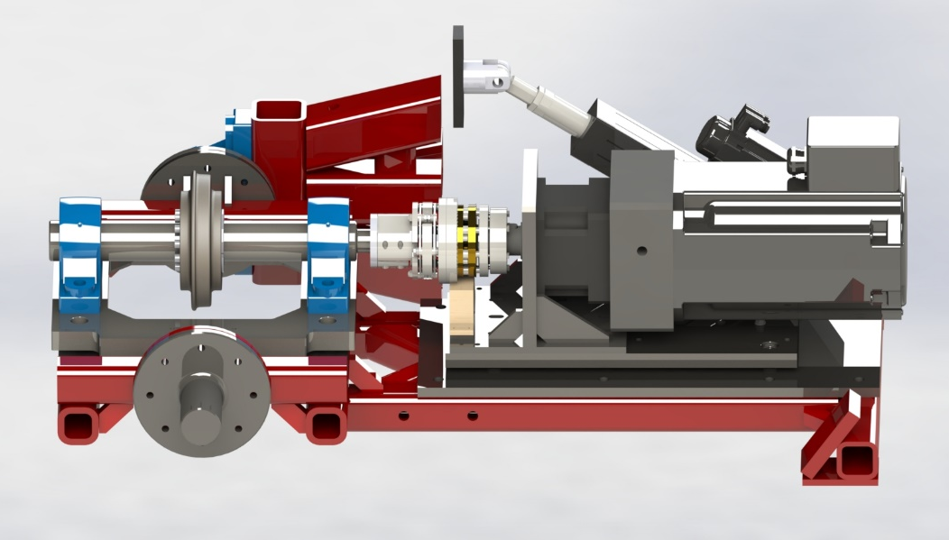
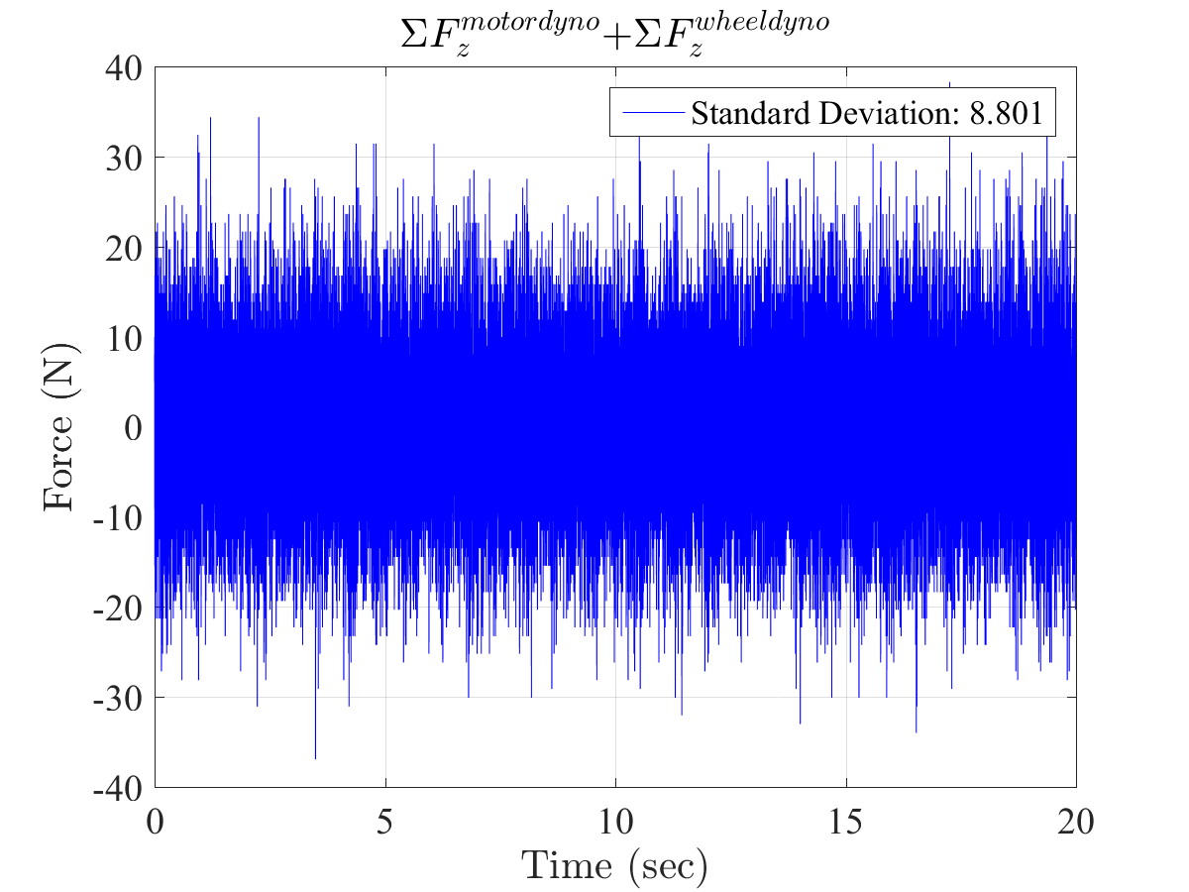
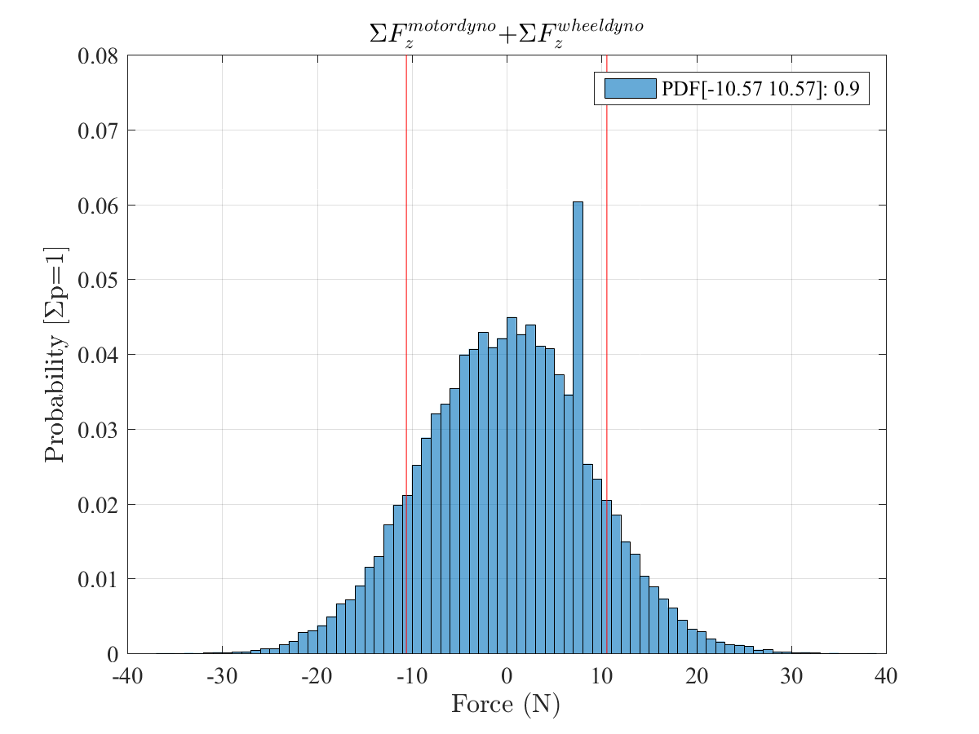
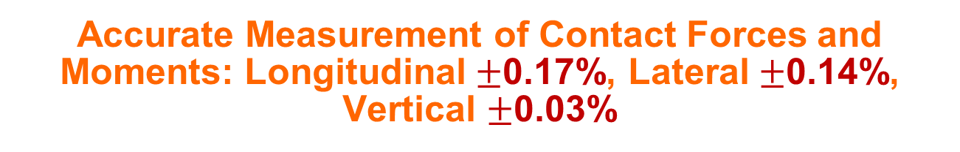
Accurate Measurement of Contact Forces and Moments: Longitudinal $±$0.17%, Lateral $±$0.14%, Vertical $±$0.03%
Forces and Moments:
Static
Condition
Torsion-Proof Multi-Disk Coupling
Load-Path Through the Primary Platform
Commanded Force
Wheel Dynamometer
Wheel-Roller Contact
Load-Path Through the Driveline
Motor Dynamometer
Probability Distribution Function (PDF) of Vertical Forces
Direction | Standard deviation (σ) of the baseline error with no motion and drive disabled | Standard deviation (σ) of the baseline error on the move (motor contribution) | 90th percentile baseline error in motion
X | 1.003N | 13.923N (92.80%) | 13.59N
Y | 1.046N | 11.342N (90.78%) | 11.48N
Z | 2.036N | 8.801N (76.87%) | 10.57N

Slide 15
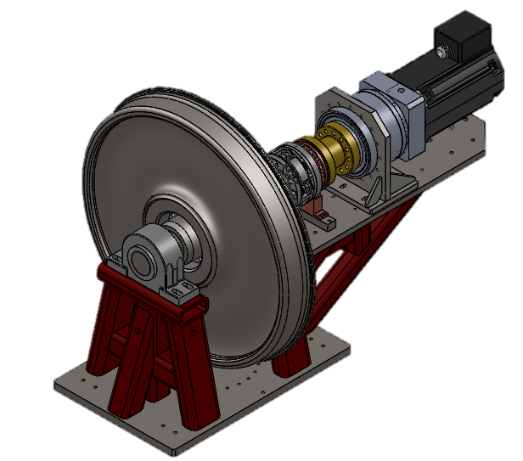
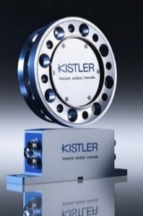
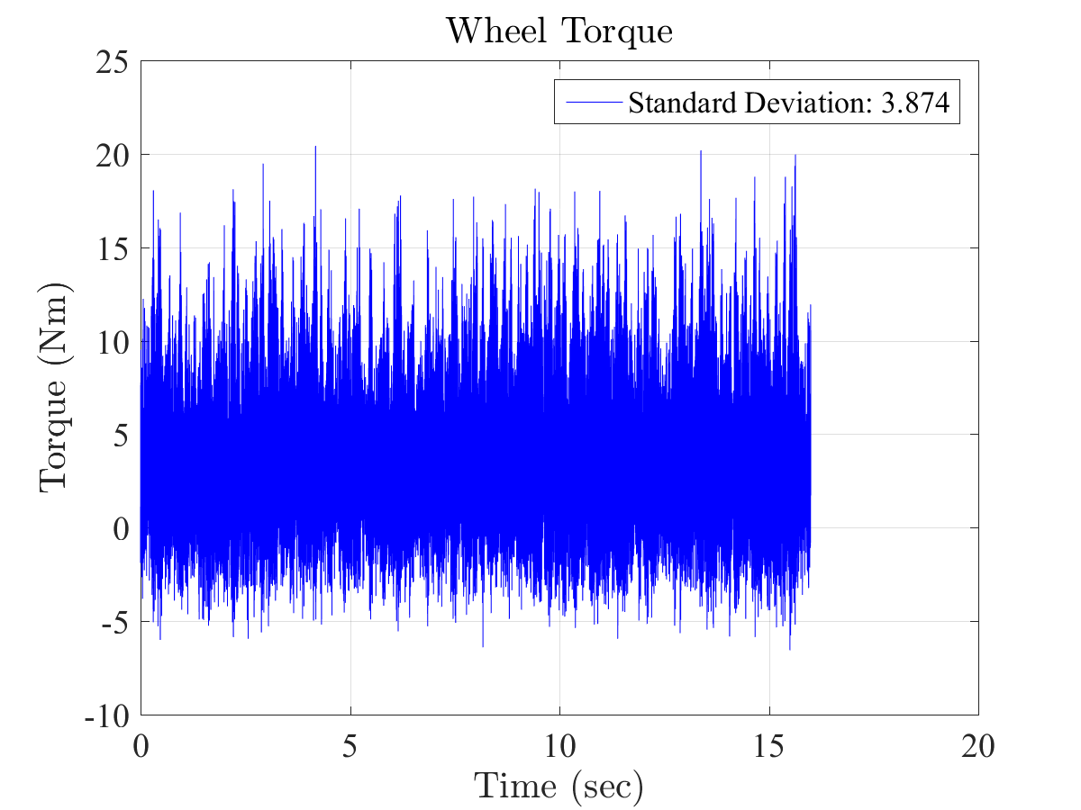
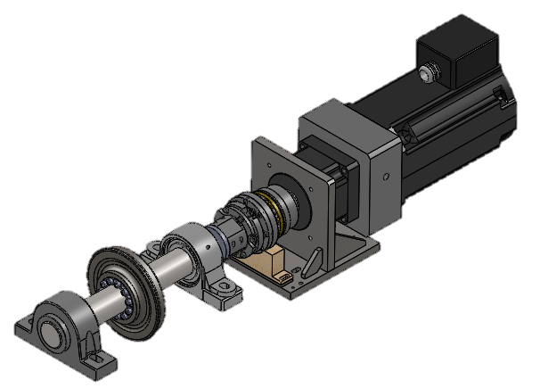
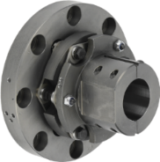
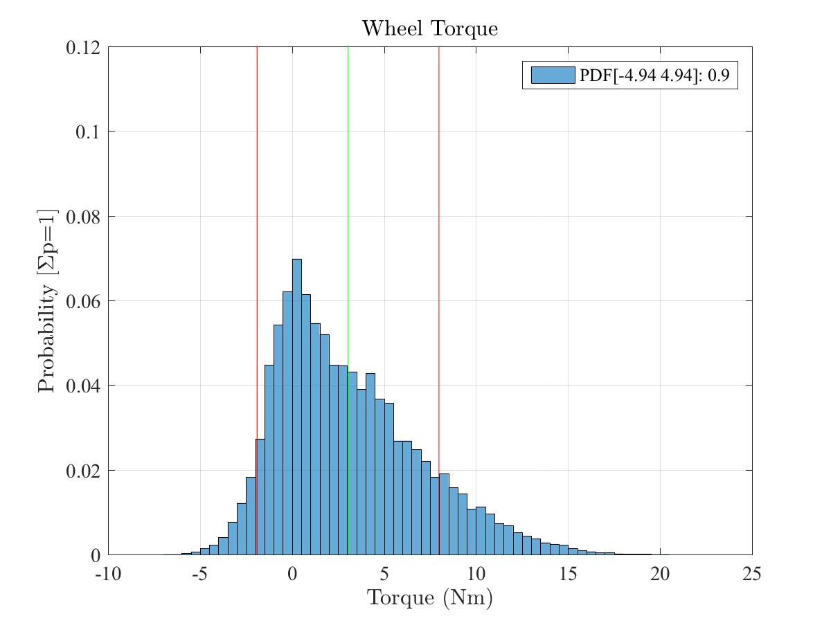

Accurate Torque Measurement: Wheel driveline $±$0.24%, Roller driveline $±$0.06%
Driveline Torque:
Static Condition
Commanded Torque
Axis | Standard deviation (σ) with no motion and drives disabled | Standard deviation (σ) at constant speed (motor contribution) | 90th percentile at constant speed
Wheel | 1.484Nm | 3.874Nm (61.69%) | 4.94Nm
Roller | 7.908Nm | 7.951Nm (0.54%) | 6.10Nm

Slide 16
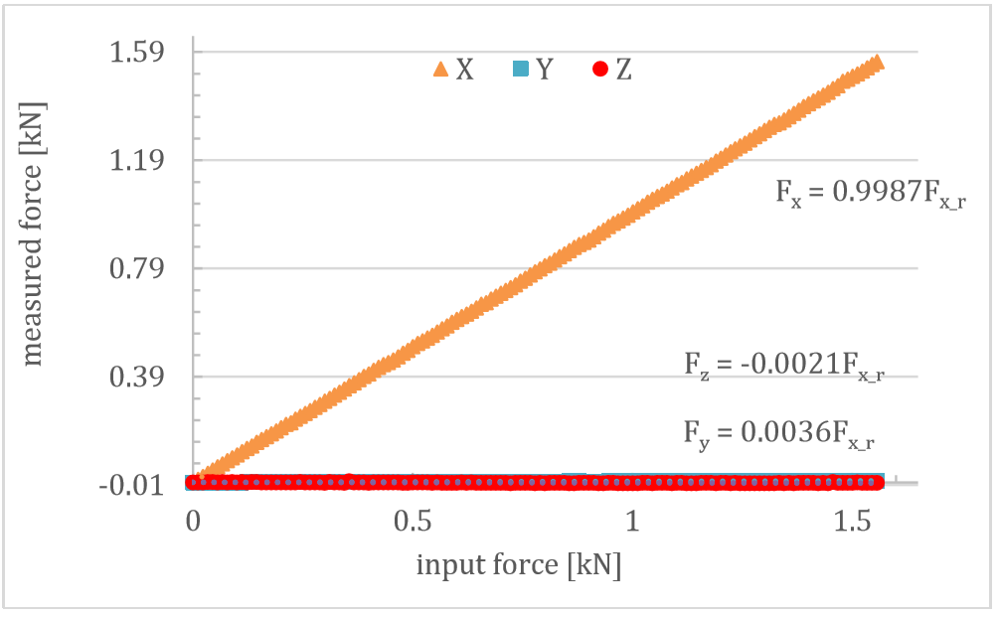
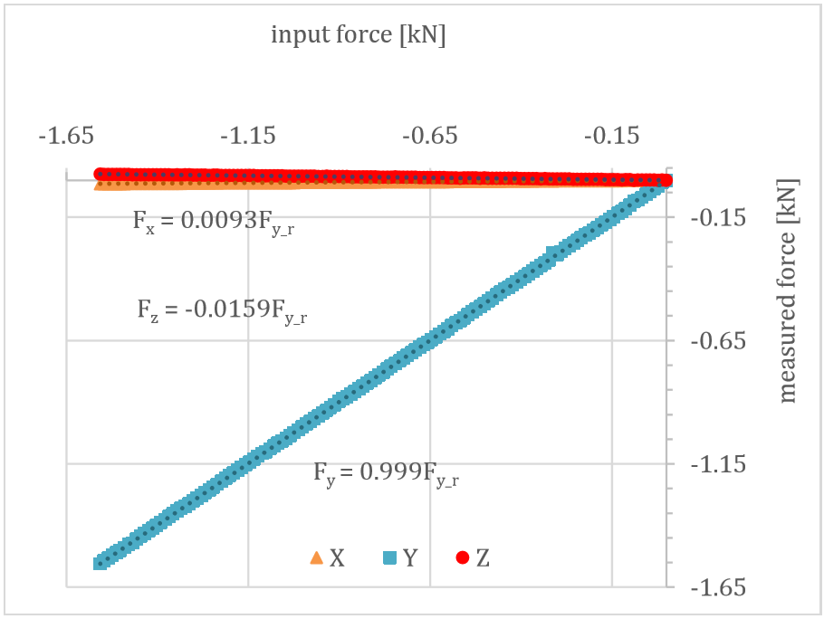
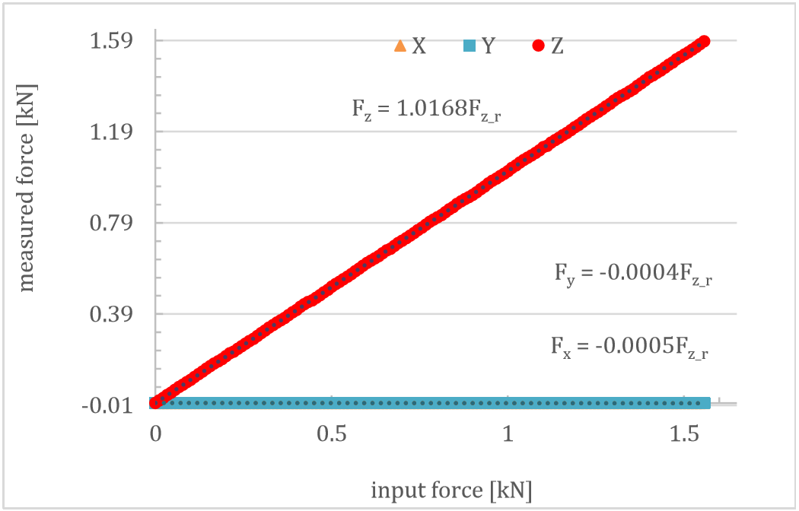
Extensive calibrations are conducted on the dynamometers
Accuracy of load cells: Quasi Static
Calibration
Quasi-static & cross sensitivity curves for input force in x-direction
Quasi-static calibration
2.5 lbs weight blocks individually in each axis & summated signals recorded
Procedure repeated 3 times
Best linear line fitted through the data
Quasi-static & cross sensitivity curves for input force in y-direction
Quasi-static & cross sensitivity curves for input force in z-direction

Slide 17
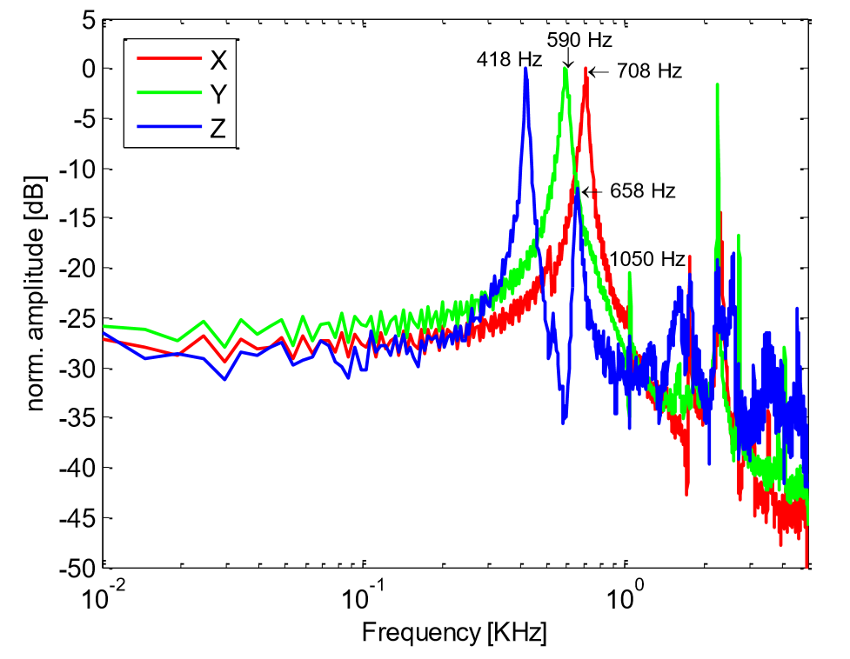
Dynamic Calibration of Dynamometer Using Impact Response
Impact test
Natural frequencies are obtained (300 Hz motor dyno, 420 Hz wheel dyno)
Modal frequencies indicated on the frequency response function
Accuracy of load cells: Dynamic
Calibration
Impact frequency response of dynamometer for an impact in x,y,z direction

Slide 18
Current Testing Methodology
Design of Experiments is discussed in this section

Slide 19
Experiment Steps
Current Testing
Surface Cleaning
Cant, AoA
Verification
Reference Positions Defined
Unloading and Setup Reset
Data Collection for 5 seconds
Rig Loaded and Motion Started
The above cycle is repeated for creepages from 0 – 4% with increments of 0.1%. Replications are done and Base Speed changed

Slide 20
Data Processing
Current Testing
Raw Data
Fs = 2kHz
Bitstream Stored on Workstation
File Tagging, Parameter ID
Data Import, Batch
Processing
Coherence Testing
Causality Analysis
LPF
f_{b} : 10 Hz
Data
Merge
Normalized Creep
Computation
Taking Experiment
Means
Curve Fitting

Slide 21
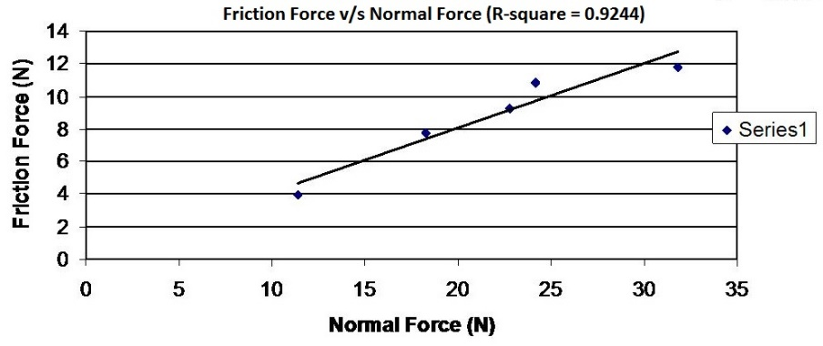
Causality Analysis
Data Processing:
Features
Done to check false readings by instrumentation noise floor
Every friction model predicts an increase in Longitudinal force for an increase in Vertical force
Trend fit is generated on a plot of longitudinal force vs vertical force
Idea: A good fit with an increasing trend is an indication of causality
Noise is non-causal, will not generate good fit and will not show proper trend
Typical Traction-Normal experiment to determine friction coefficient. Very good straight line fit

Slide 22
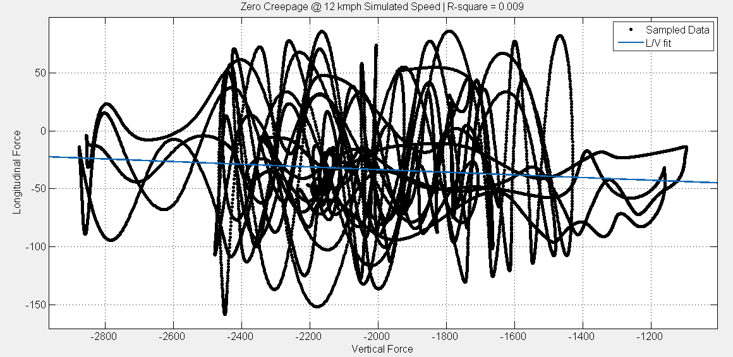
Noise Floor ID
Causality Analysis
Very Low R², Non Causal Longitudinal and Vertical Forces, High Noise Corruption, Reject Data

Slide 23
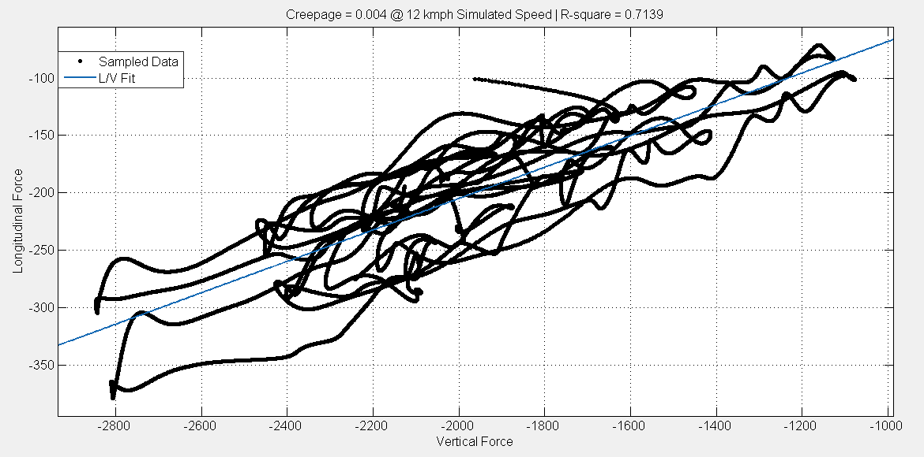
Positive Trend – Minimal Noise Impact
Causality Analysis
Good R², Causal Longitudinal and Vertical Forces, Low Noise Impact, Accept Data

Slide 24

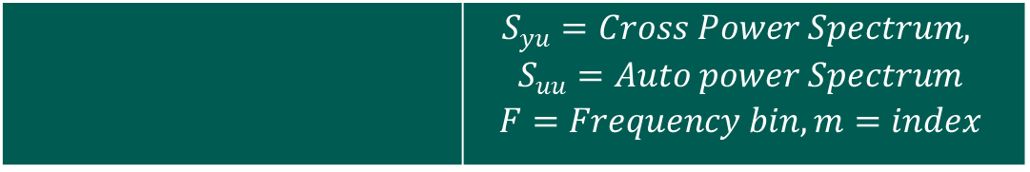
Coherence Testing
Data Processing:
Features
Secondary check to establish input-output causality
The coherence between longitudinal force (output) and vertical load (input) is established
Strong Coherence ( > 0.9) indicates strong correlation
Weak Coherence indicates weak correlation
Frequency region of interest is 0-1 Hz, same as the Wheel/Roller rotational frequencies. Any other spectrum data is not due to variation in L forces
 | $$S_{yu}=Cross Power Spectrum,$$ $$S_{uu}=Auto power Spectrum$$ $$F=Frequency bin, m=index$$

Slide 25
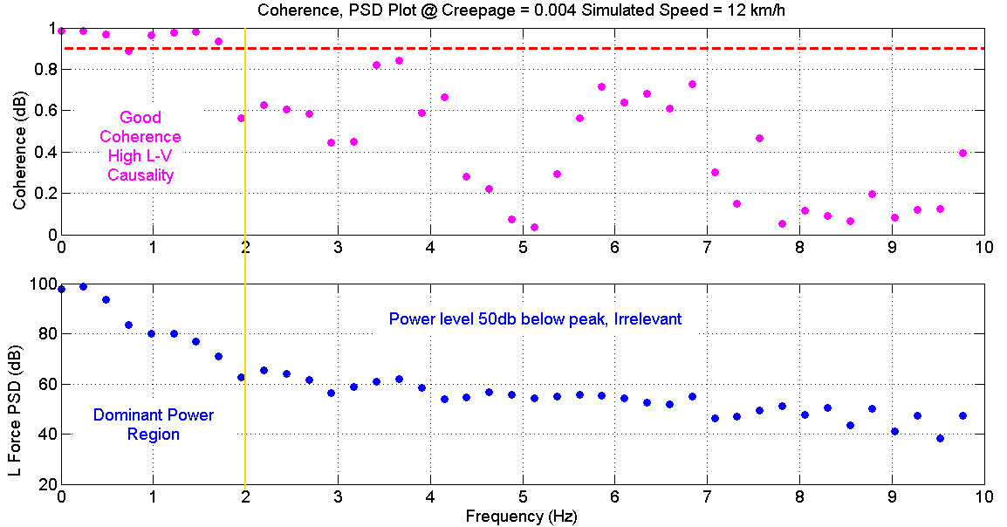
Strong Coherence, Accept Data
Coherence Testing
Forcing Frequencies: f_{Wheel} = 1.14 Hz | f_{Roller} = 0.16 Hz and Harmonics of high power define region of interest (0-2 Hz)

Slide 26
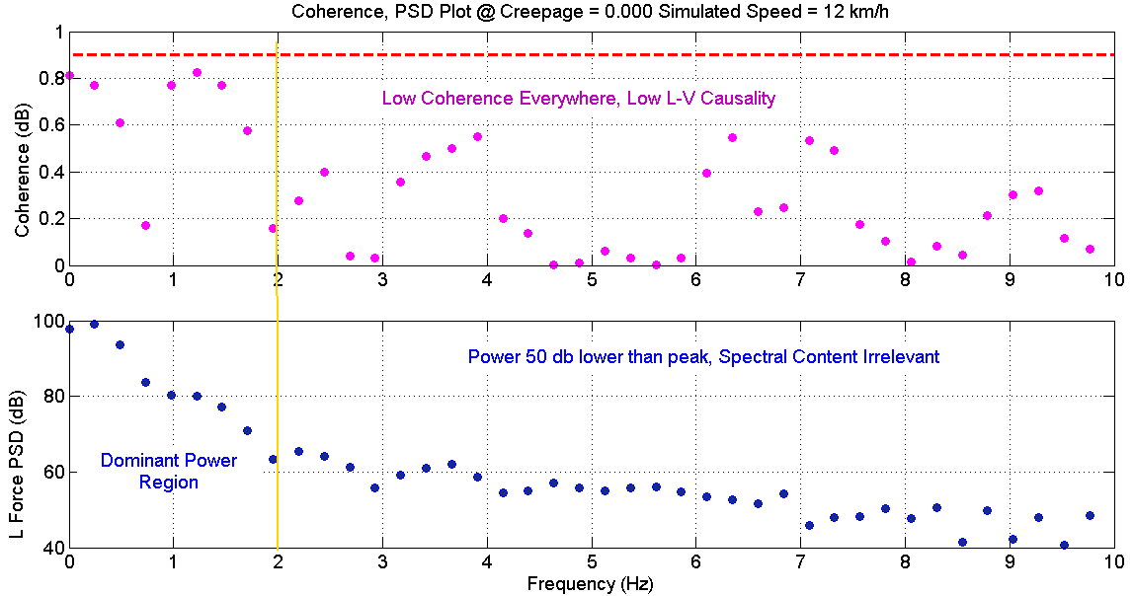
Low Coherence, Reject Data
Coherence Testing
Forcing Frequencies: f_{Wheel} = 1.14 Hz | f_{Roller} = 0.16 Hz and Harmonics of high power define region of interest (0-2 Hz)

Slide 27
Data Reporting
Data Processing:
Features
Normalized Longitudinal Force array computed by element-wise division of longitudinal and vertical force arrays
Means from each experiment are computed separately.
All of the data is combined together and a best fit relation is fit to obtain the creep-creepage curve

Slide 28
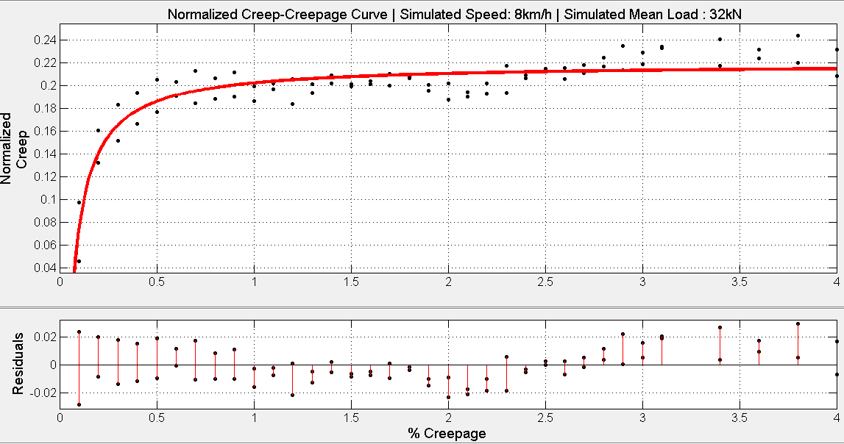
Results: Good Fit, Low Dispersion
Results’ Analysis
Points close to 0 Creepage have a non-zero mean but very low causality. Data is ignored from those experiments & not shown

Slide 29
DoE Summary
DoE Summary
Completely Randomized Design of Experiment with
Same loading conditions
Same velocity conditions
Relatively small amount of time with the rig (a few months)
Piezoelectric drift reduction
Replications increase statistical significance of data
Causality and Coherence testing to check false data
Repeatable, Actual Physics’ Data achieved
Work in Progress

Slide 30
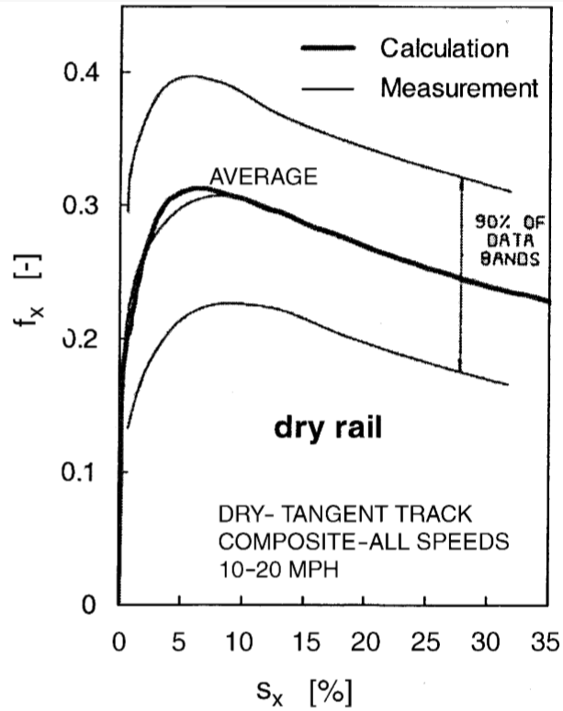
Previous Work
Literature
Comparison
Full Scale Rig
GM SD 45X locomotive
V = 16–32 km/h
Dry Conditions
+/- 0.1 L/V for 90% confidence
Used for computing his modified model
[1] O. Polach., “Creep forces in simulations of traction vehicles running on adhesion limits," Wear, vol. 258, pp. 992-1000, 2005.
Notice that the actual data points are not shown!

Slide 31
Comparison with Polach’s work
Literature
Comparison
1/4 Scale Rig
Cylindrical Wheel profile, Used Wheel and Roller
V = 12 km/h (Sim.) Load: 32 kN/wheel (Sim.)
Clean, Dry Conditions
+/- < 0.05 L/V for 95% confidence
Reduced Loading, Velocity conditions
Expected minimal contact distortion
Shape follows Polach’s measurements
More creepages is required for a complete comparison

Slide 32
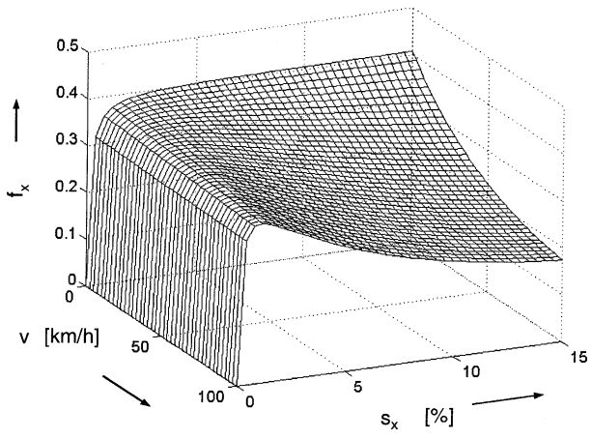
Base Speed Dependence on Creepage Curves
Vehicle Speed
Third Dimension
Same loading conditions
Different base speeds: 4,8,12 km/h
Polach’s model predicts a change in creep behavior with vehicle speed
Simulation results presented
Influence of vehicle speed on the form of creep force–creep functions for longitudinal direction; model parameters according to measurements

Slide 33
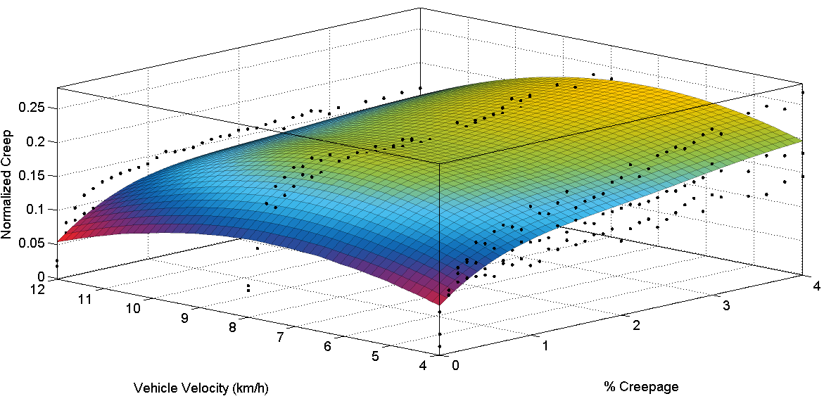
Our Results for Vehicle Speed Dependence
Vehicle Speed:
Third Dimension

Slide 34
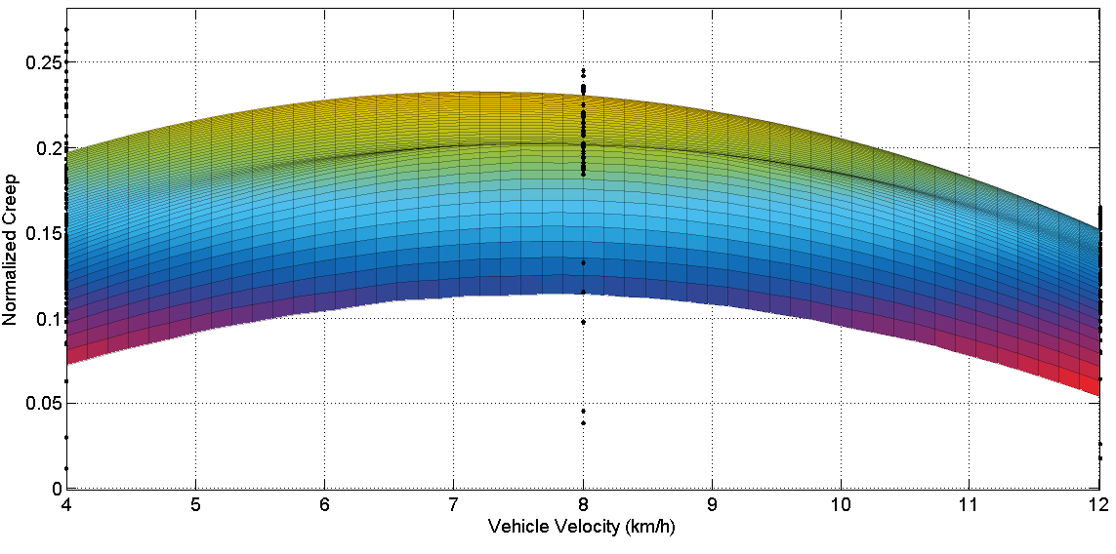
Our Results for Vehicle Speed Dependence
Vehicle Speed:
Third Dimension
Further analysis is needed to establish definitive trend

Slide 35
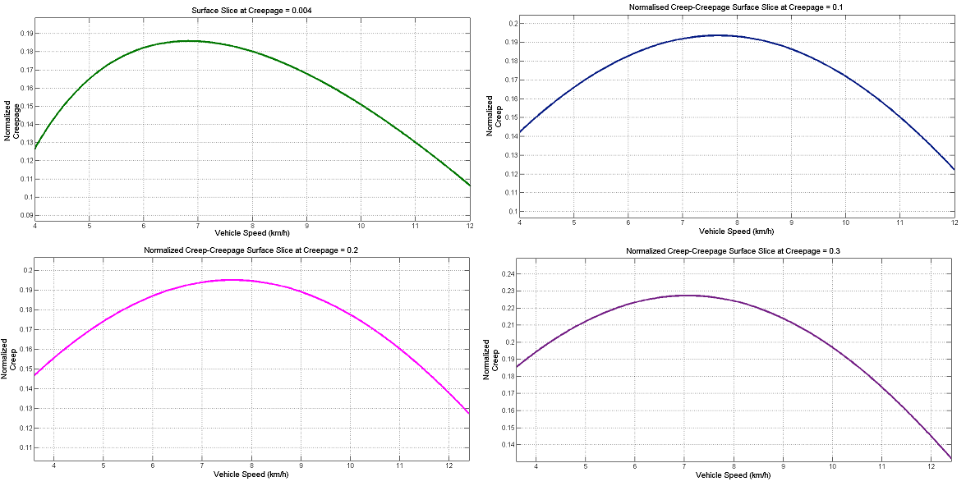
Quad Chart: Vehicle Speed Dependence
Vehicle Speed:
Third Dimension
Further analysis is needed to establish definitive trend

Slide 36
Future Tasks
Future
Tasks
Sensor drift and error dynamics to be quantified
More data to be collected for stronger validation
Effects of the following to be examined:
Cant Angle
Angle of Attack
Vertical Load
Base Speed Dependence
Zeroing instrumentation for all degrees of freedom
Testing automation using Mechaware libraries

Slide 37
Rig’s Capabilities
Rig’s Capabilities
Dry testing
Lubricated wheel/rail testing
Hollow wheel testing
Worn wheel testing
Testing various wheel materials
Testing various wheel profiles
Testing under various cant angles, AoA, lateral positions
Flange contact; 2 & 3 point contact studies
Wheel vibration studies
Various creepage testing

Slide 38
Potential Future Studies
Potential Future Studies
Validation of creep models such as CONTACT
Effect of worn wheel on L/V forces
Effect of large AoA on creepage dynamics
Effect of wheel/roller lubricants on creepage dynamics
Effect of hollow wheel & large AoA on L/V forces
Effect of cant angle on L/V forces & creepage dynamics
Validation of friction models sponsored by FRA
RCF studies
Assessment of new hypotheses and theories

Slide 39
Thank you!

